Slide 1

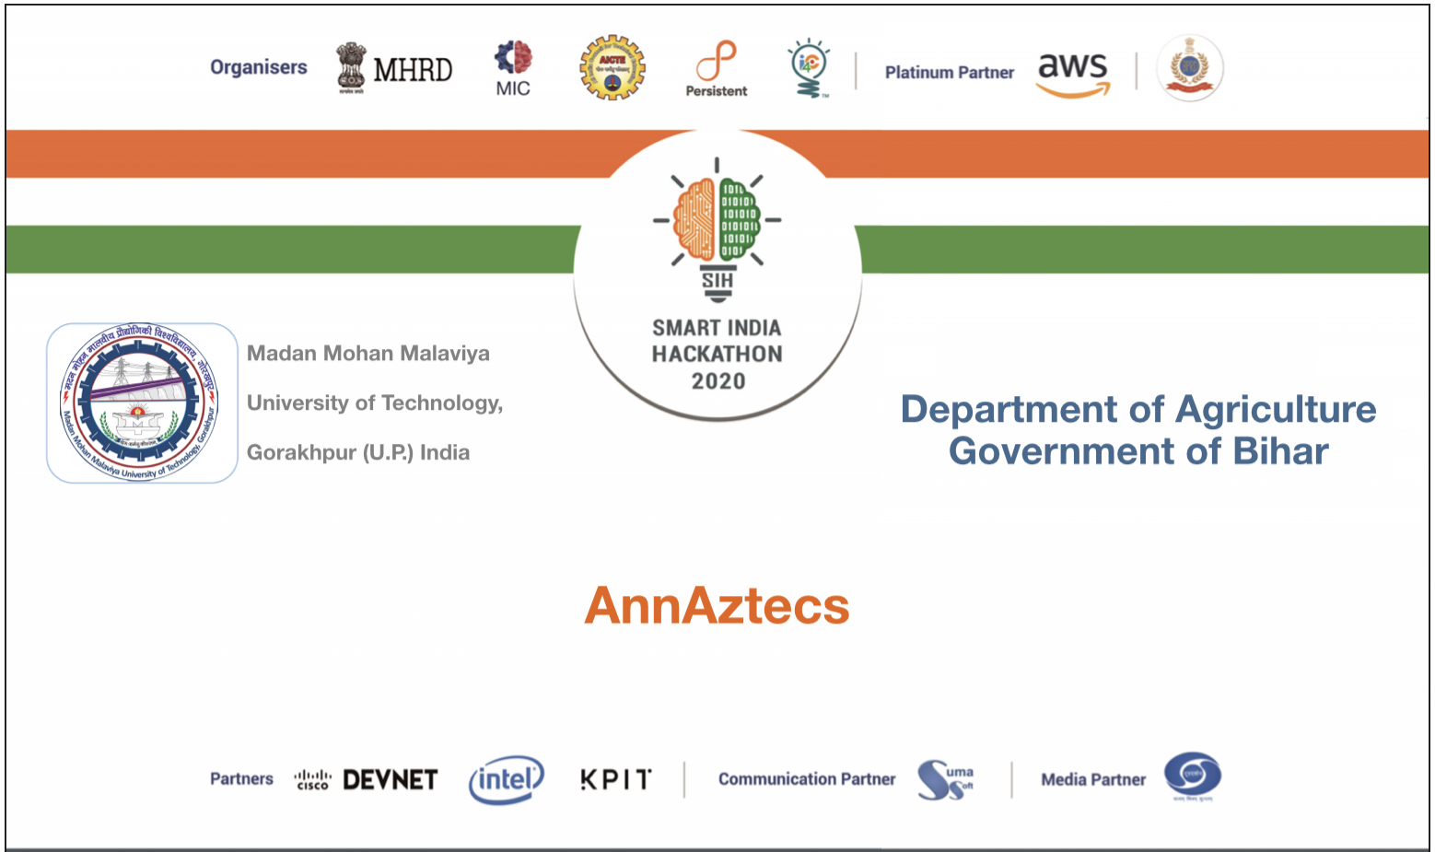
Smart India Hackathon 2020
Ministry/Organisation name : Govt. of Bihar (DOA)
Team Name : AnnAztecs
College Code : 1-3516007856

Slide 2
Problem Statement
Developing an e-enabled real time produce life cycle monitoring & sharing mechanism to enhance output realization to farmers through private sector
participation and DBT.
Our interpretation of the problem statement
Creation of a portal that takes nominal details from farmers, fetches further details depending on the primary details and uniquely identifies the farmer and his farm. Further, identification of the crop grown, providing yield prediction of each crop to the government. Moreover, dedicated sections in the portal for registration of farmer, booking of seeds (private sector participation) and for governmental admin. Eventually, the monetary value of yield to be transferred in farmer’s account (DBT) which also serves the purpose in case of loss compensation.

Slide 3

Plan description :
We figured out that the keyword in the problem statement was produce life cycle So, our team decided to model our solution over it. Here is how,
Crop Selection
Harvesting
Land Preparation
Produce Life Cycle :
Crop Growth
Seed Sowing
Irrigation

Slide 4
Crop Selection - There is a little that we could have done here since a farmer uses his experience and discretion while selecting a crop. Nevertheless, our portal will suggest him a crop in accordance to the previous year yield.
Land Preparation
Seed Selection - This is where private sector participation can be realised. Government can outsource a seed selection, purchase and delivery service. A call centre to be established where a farmer calls and provides credentials, the call centre employee uses the dedicated seed booking page of our portal to book the best seed for the calling farmer.
Seed Sowing
Irrigation - Check availability of water resources near the farm. If a farm is remotely located from water resources, it is but natural that the seeds should be such that needs lesser water. This flag would be used in future for Step 3 i.e Seed Selection.
Crop Growth - This is the most important part of the cycle from our viewpoint. If a crop gets wasted due to flood (as in the current days) , farmer can call on same call centre and register their damage. Cross verification of the damage would be done through the same machine learning model that will be used for crop identification. If the damage is verified, the magnitude of the damage is decided and the monetary value is shown to the government (for compensation transfer). If the crop growth is normal, another machine learning model would predict the yield of each crop. This will be used by the government to decide a better MSP for each crop.
Harvesting

Slide 5

Modules in our project
Front-end of the portal
Back-end of the portal
A QR code system for unique identification of the farmer
A system to determine availability of water resources near the farm
A system for crop identification, damage verification and yield prediction

Slide 6
Module Description
1. Front-end
A straight forward portal written in HTML and CSS. It has
Farmer registration page - for new farmers joining the system.
Admin Login page - page dedicated for governmental admin. This page
will provide provision for crop identification, damage verification and yield
prediction.
Seed booking, information and order tracking pages - pages providing facility for call centre representative to book and track and seek details about seeds.

Slide 7
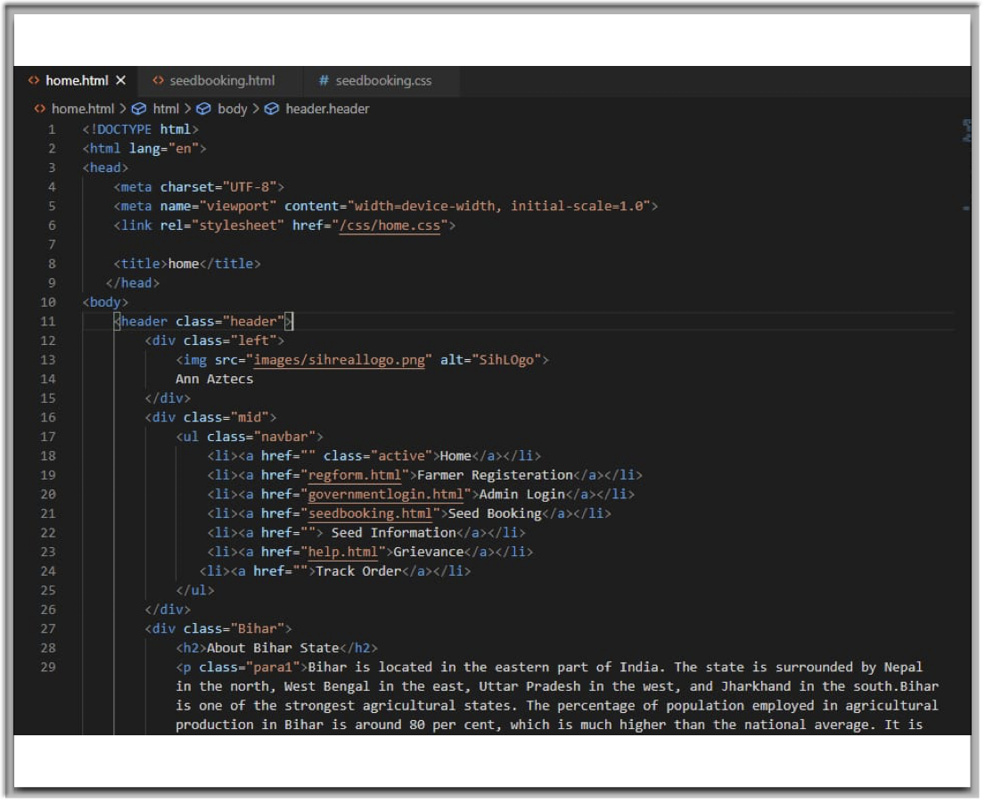
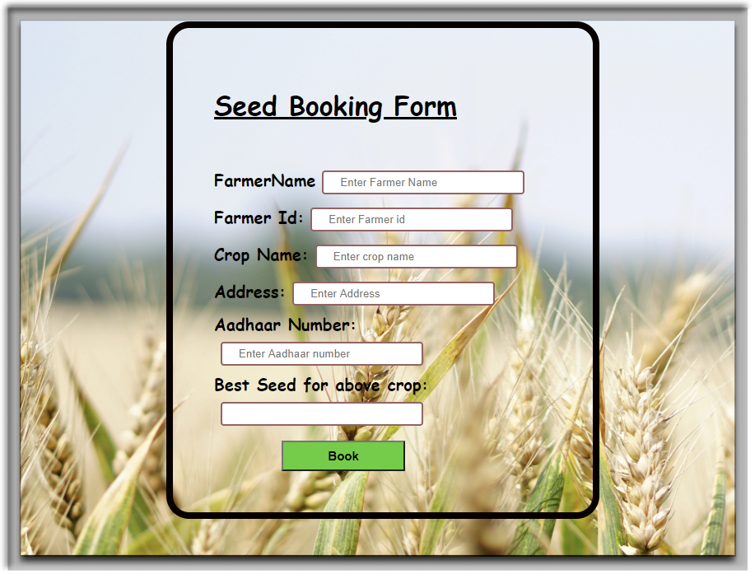
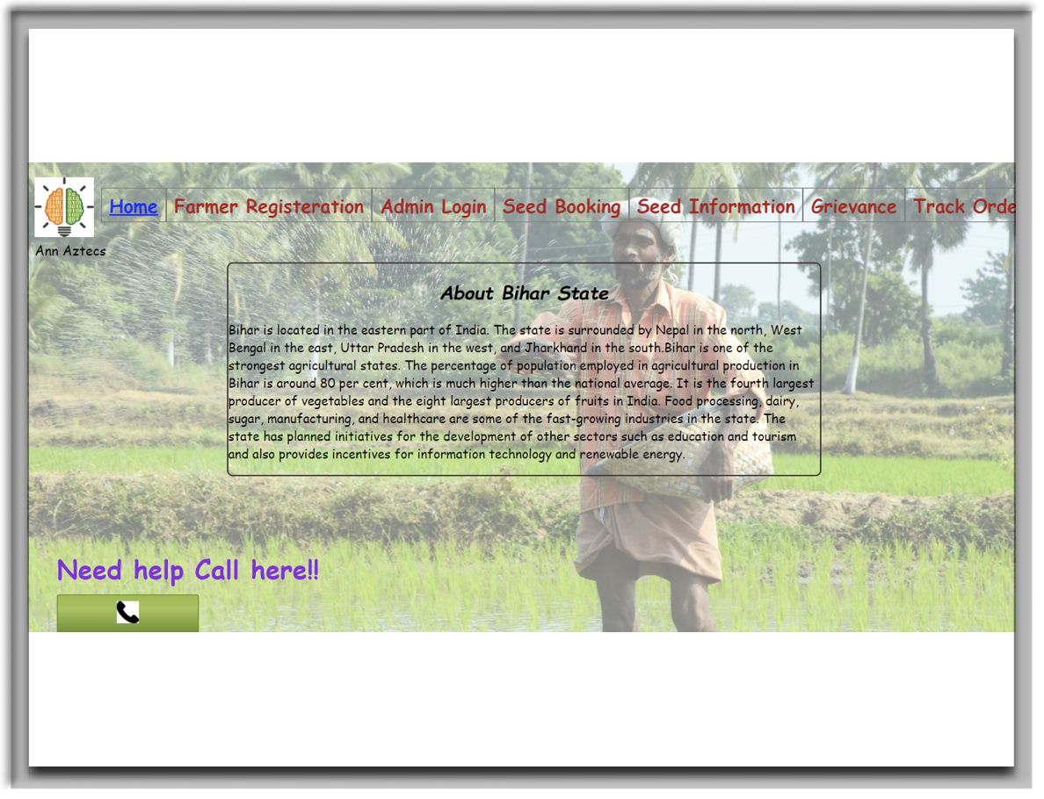
Snippets of the front-end -
Sarika Upadhyay(AnnAztecs)

Slide 8
2. Back-end
Developed in node.js
Database has a ‘farmer’ relation that contains its id, name, district, village, land record number, area, type of soil, coordinates of farm, nearby water resources and bank account number.
It also stores the data about seed booking and tracking.

Slide 9
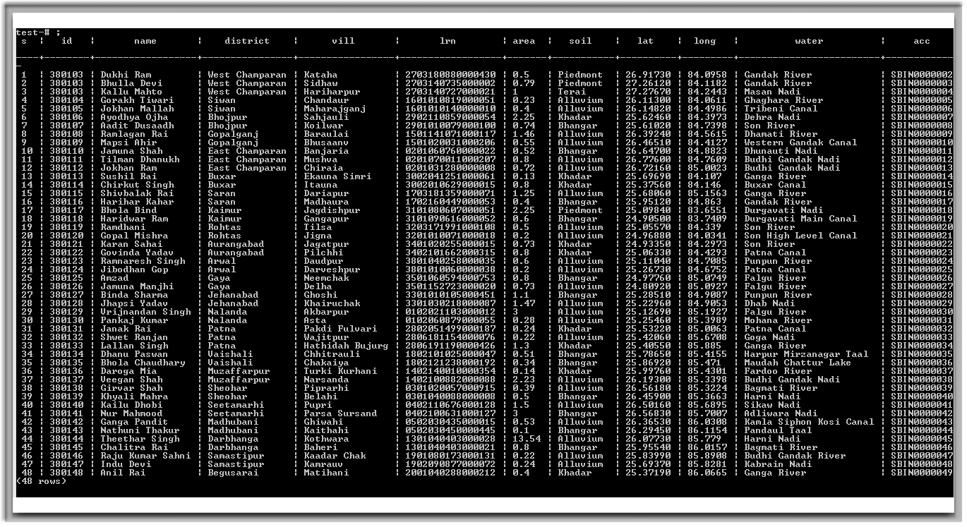
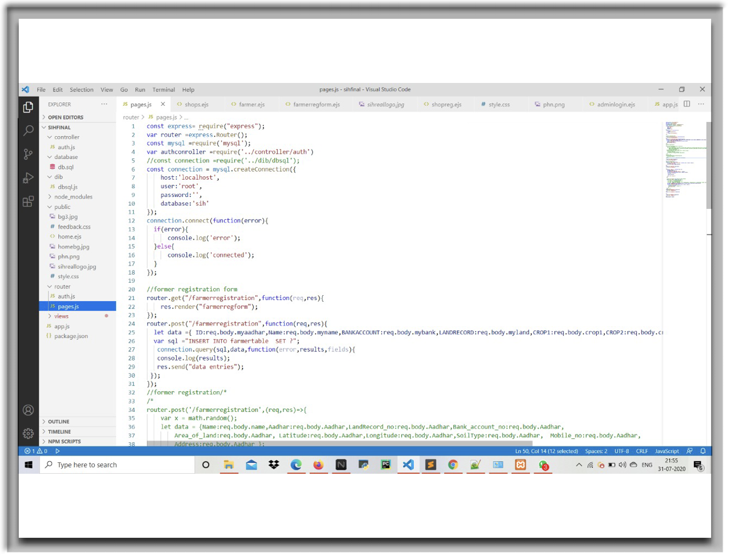
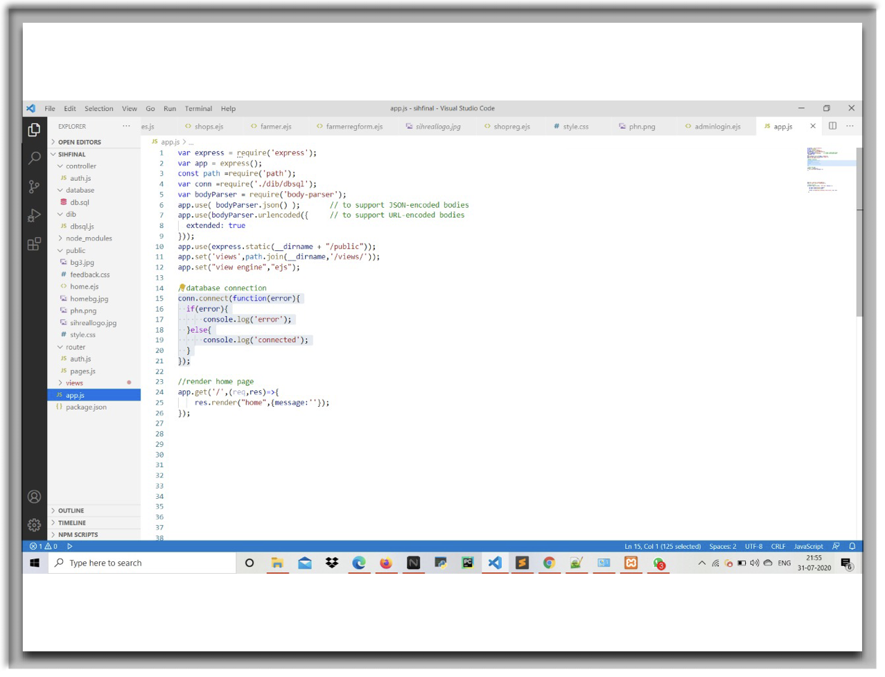
Snippets of the back-end -
Manish Kumar Yadav and Rahul Pandey(AnnAztecs)

Slide 10
3. QR code system
A QR code maker that makes QR code based on selective columns of the ‘farmer’ database of each farmer.
This unique QR can be facilitated as an ID card of the farmer.
It can be scanned by government’s representatives to view all the details about the farmer.
The same QR is to be shown by the farmer during collection of the bought seeds to ensure that the right owner of the seeds gets it.

Slide 11
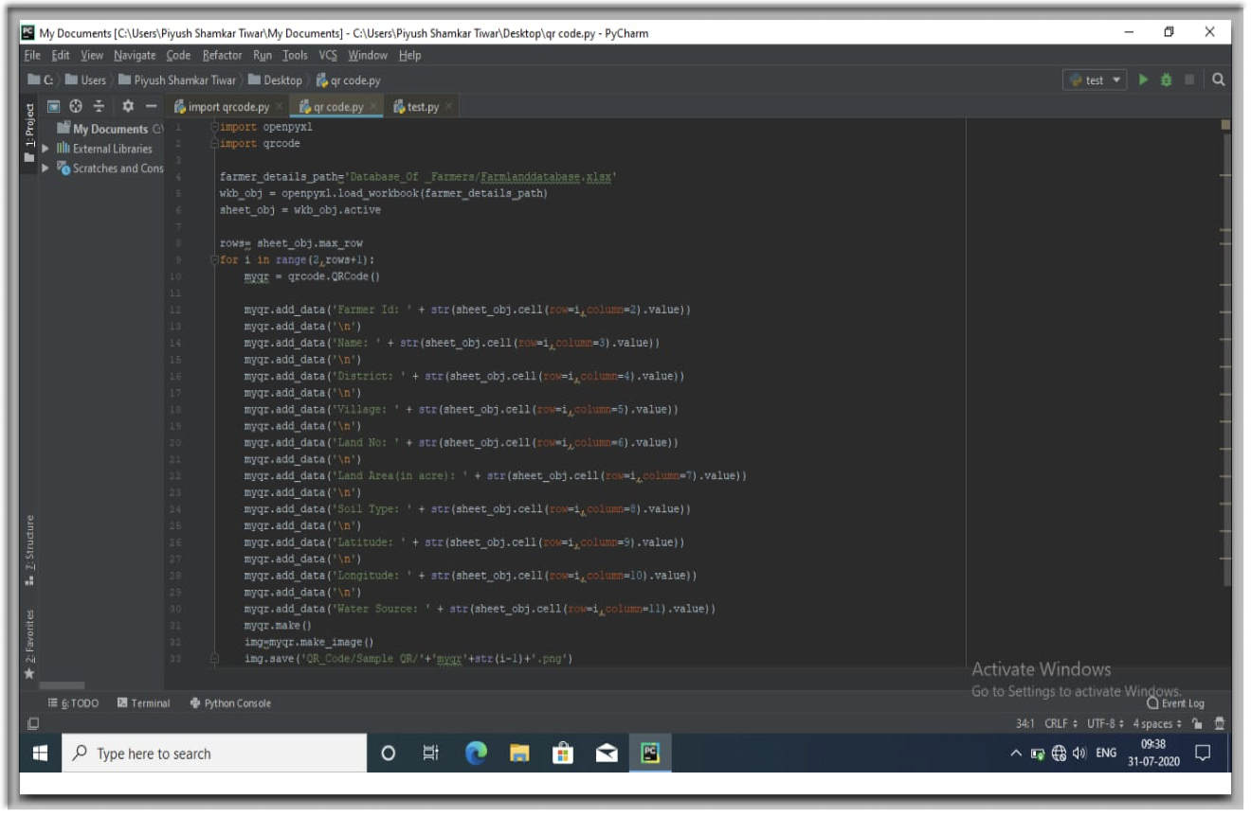
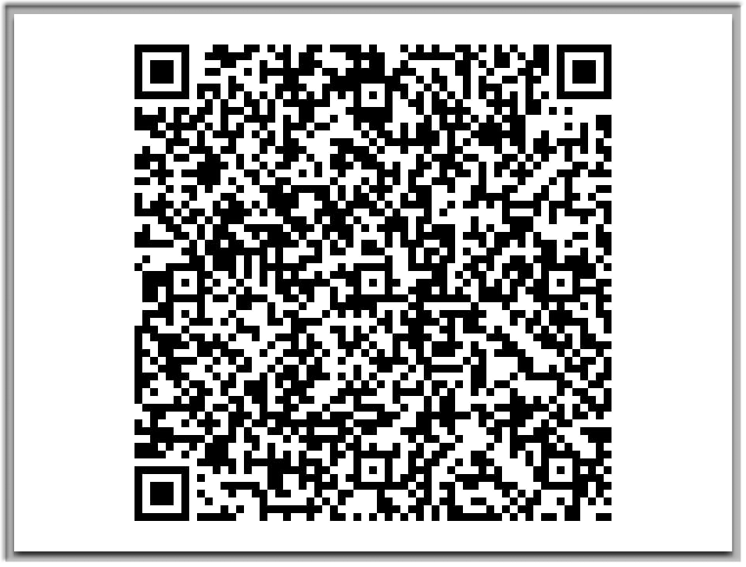
Snippets of the QR system -
Piyush Shankar Tiwari (AnnAztecs)

Slide 12
4. Water Resource Availability Detection System
Made in GNU-Octave
This system makes use of staticmap - an open source package.
This system provides an openstreetmap image of the farm with the help of coordinates of the farm
This image is processed to detect the presence of water resource nearby the farm.

Slide 13
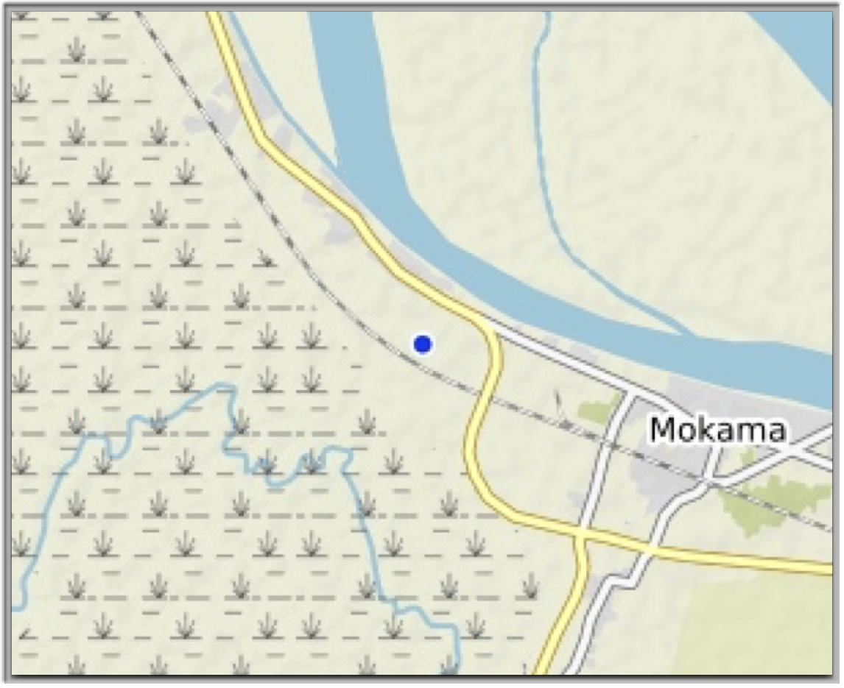
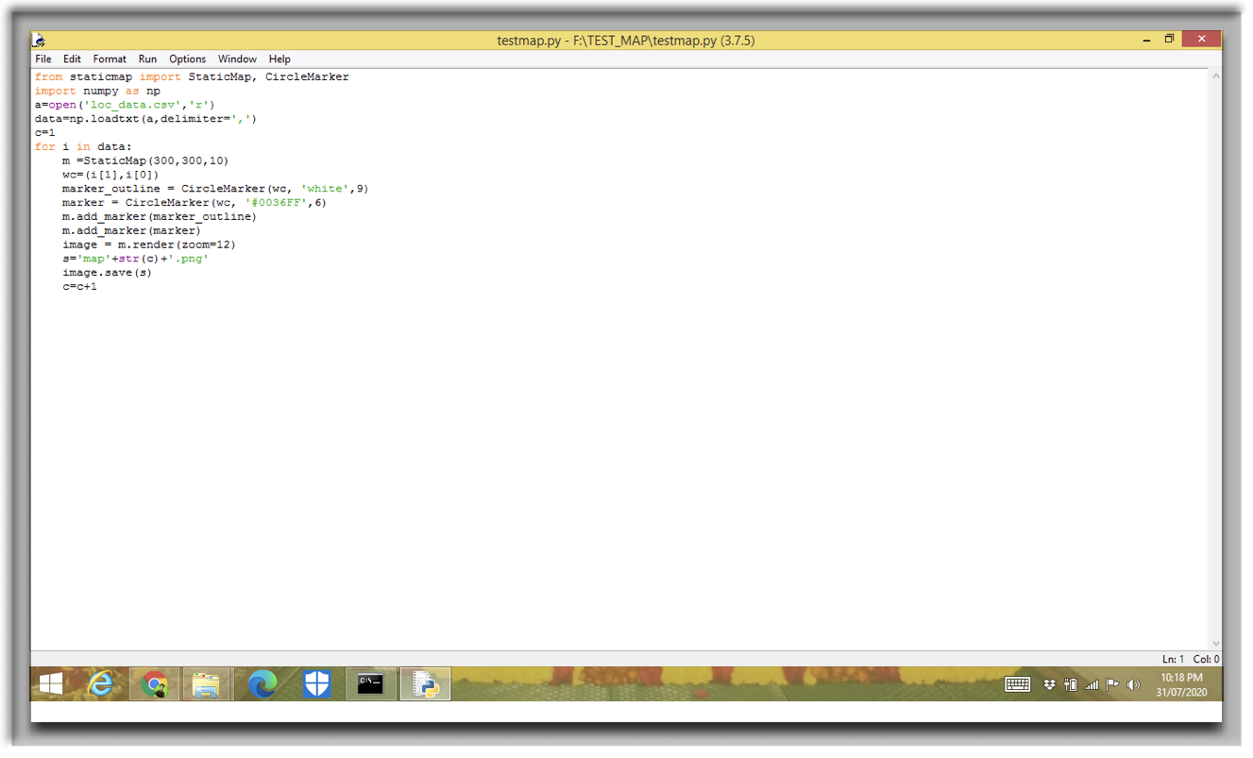
Snippets of the Water Resource Detection System -
Divyansh Srivastava (AnnAztecs)

Slide 14
5. Machine Learning System
Deep learning techniques, convolution neural network algorithm and linear regression used.
Modules and library required - python 3.6 and above, matplotlib, numpy, scikit-learn, sklearn, pandas, seaborn, opencv-python, pillow, tensorflow==2.2, keras and streamlit.

Slide 15
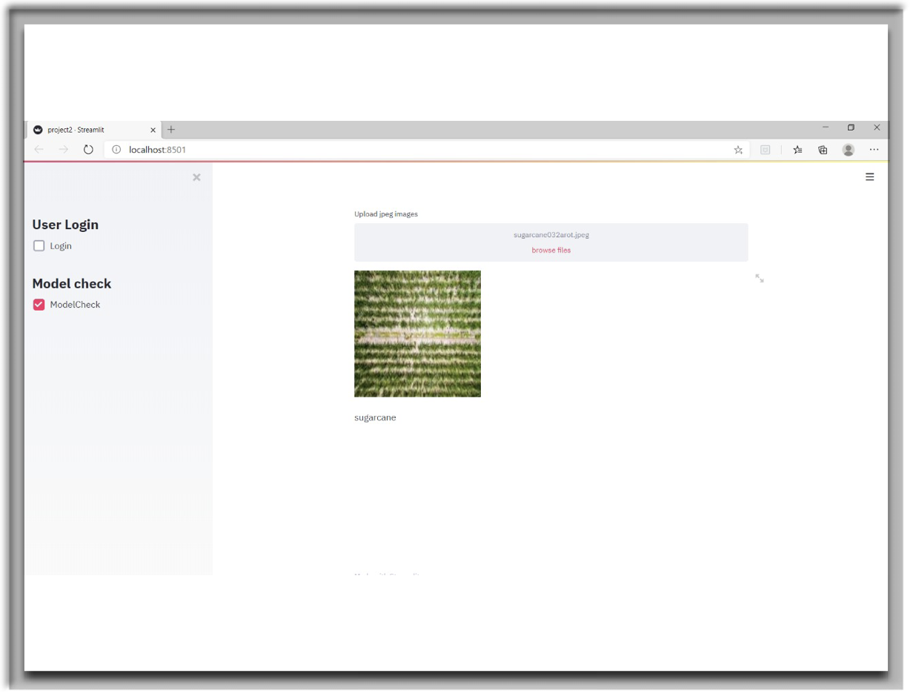
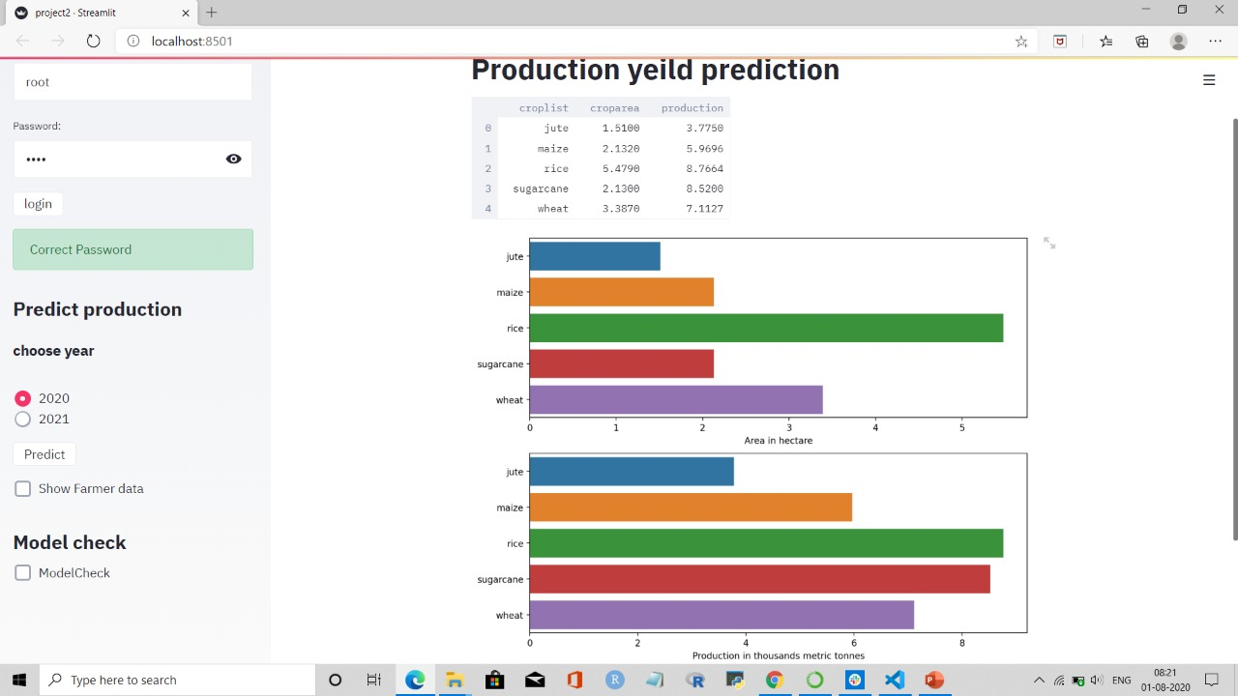
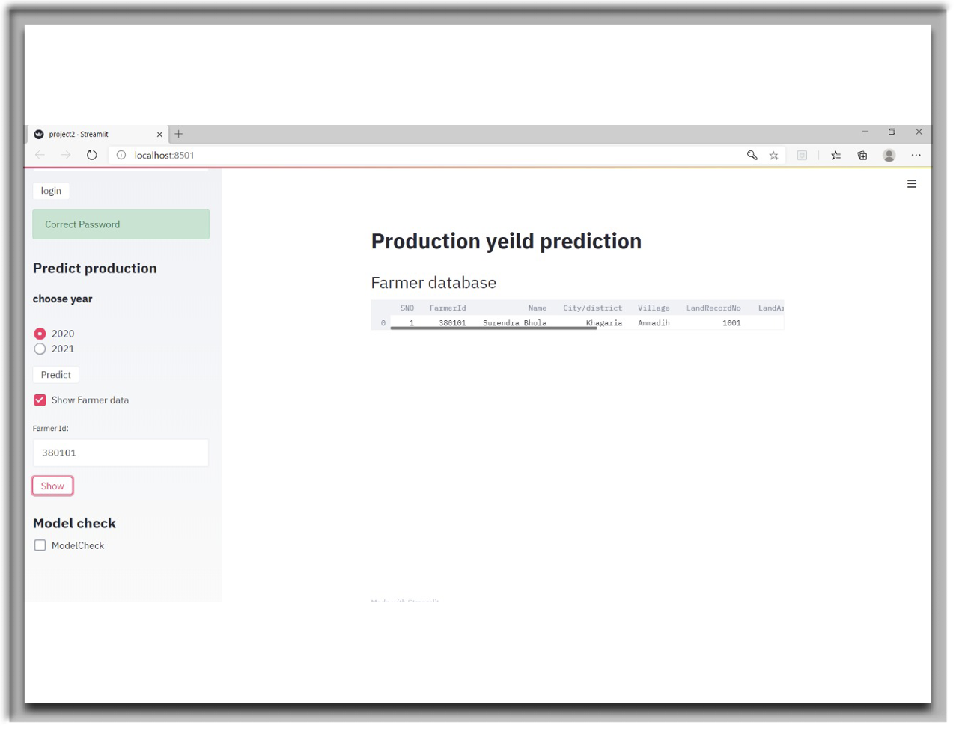

Slide 16
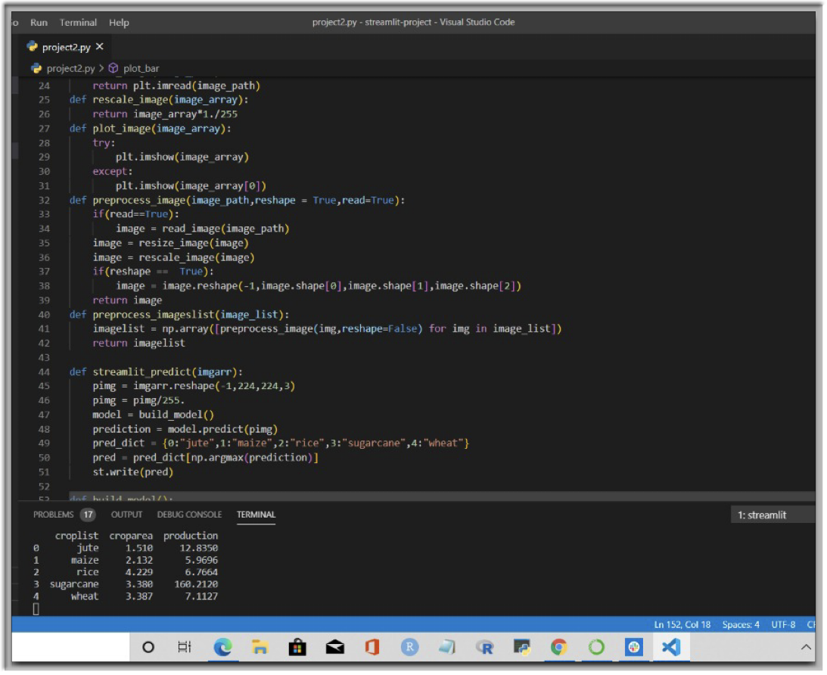
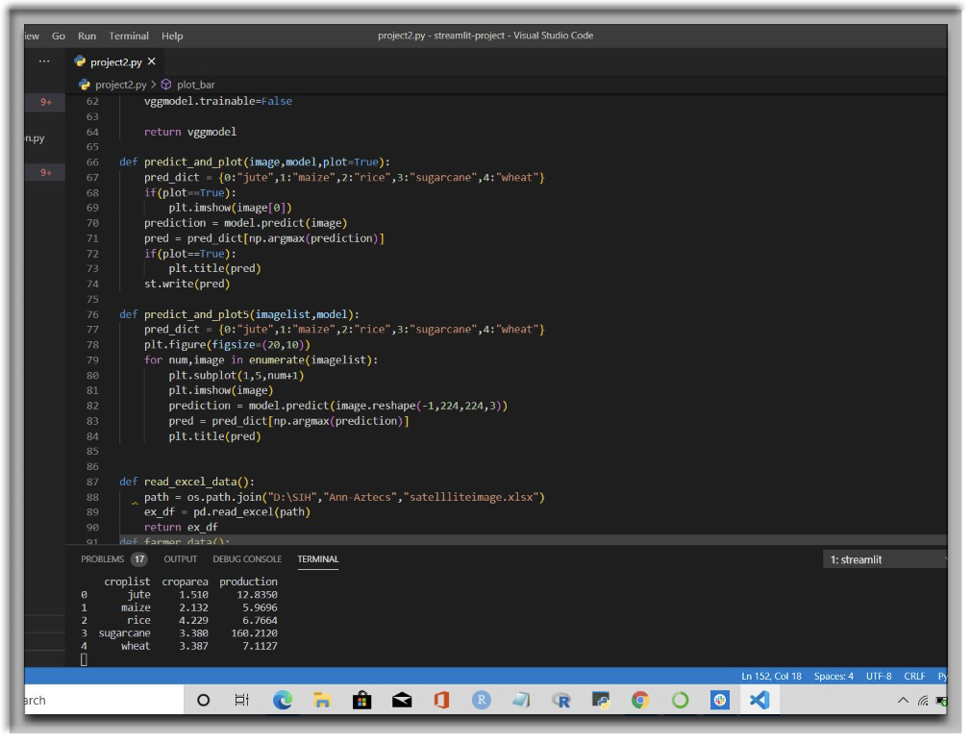
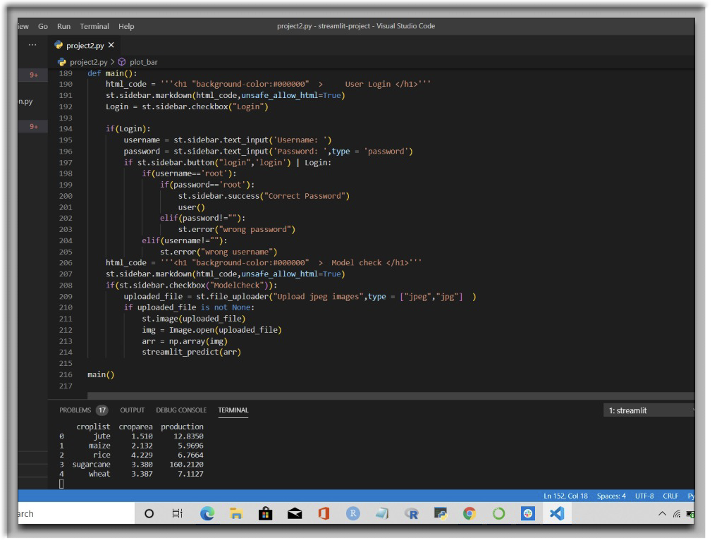
Snippets of the ML system -
Aman Jaiswal (AnnAztecs)

Slide 17
Impact
Nothing could have explained the dire need of e-enabled system than the present times. At one hand where the world is facing a global pandemic, the challenges by flood has amplified the problems in India on the other hand. Our system will reduce the physical requirement of assessment of the yield or damage to the crops. Earlier, this was done by visiting a farm or the granary, now the entire process from procurement to the delivery of seeds along with robust system determining MSP of each crop according to the yield of each crop requires nominal human need.

